Slide 1

THE STATE OF THE WORLD’S CHILDREN 2019 STATISTICAL TABLES ANALYZING CHILD MORTALITY
ALY 6070 – COMMUNICATION AND VISUALIZATION FOR DATA ANALYTICS
PROF. YONI DVORKIS
WEEK 6, OCT 22, 2020 – GROUP 2

Slide 2
CONTENTS
Sr. No. | Particulars
1 | Team Introduction
2 | Background of the Dataset
3 | Demographics
4 | Child Mortality
5 | Maternal Health
6 | Child Health
7 | Economic Indicators
8 | Action Plan
9 | References

Slide 3


Slide 4

BACKGROUND OF THE DATASET
Classified into:
UNICEF’s data on:
Demographics
Child Mortality
Child health
Maternal & Child health
Economic indicators
Under-developed
(Uganda)
Developing
(Bangladesh)
Developed
(United States)
Sections of our society
Notes:
Jyoti
Our analysis is based on UNICEF’s statistics related to child health, mortality, maternal health, demographic bifurcation of child mortality and economic indicators having direct impact on the maintaining child health and erasing mortality.
Through our research we are trying to target the 3 different sections of our society such as developed, developing and under-developing – to understand how different is the same issue based on a country’s development
For this purpose we have selected the following countries – United States, Bangladesh and Uganda.

Slide 5
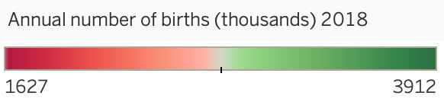
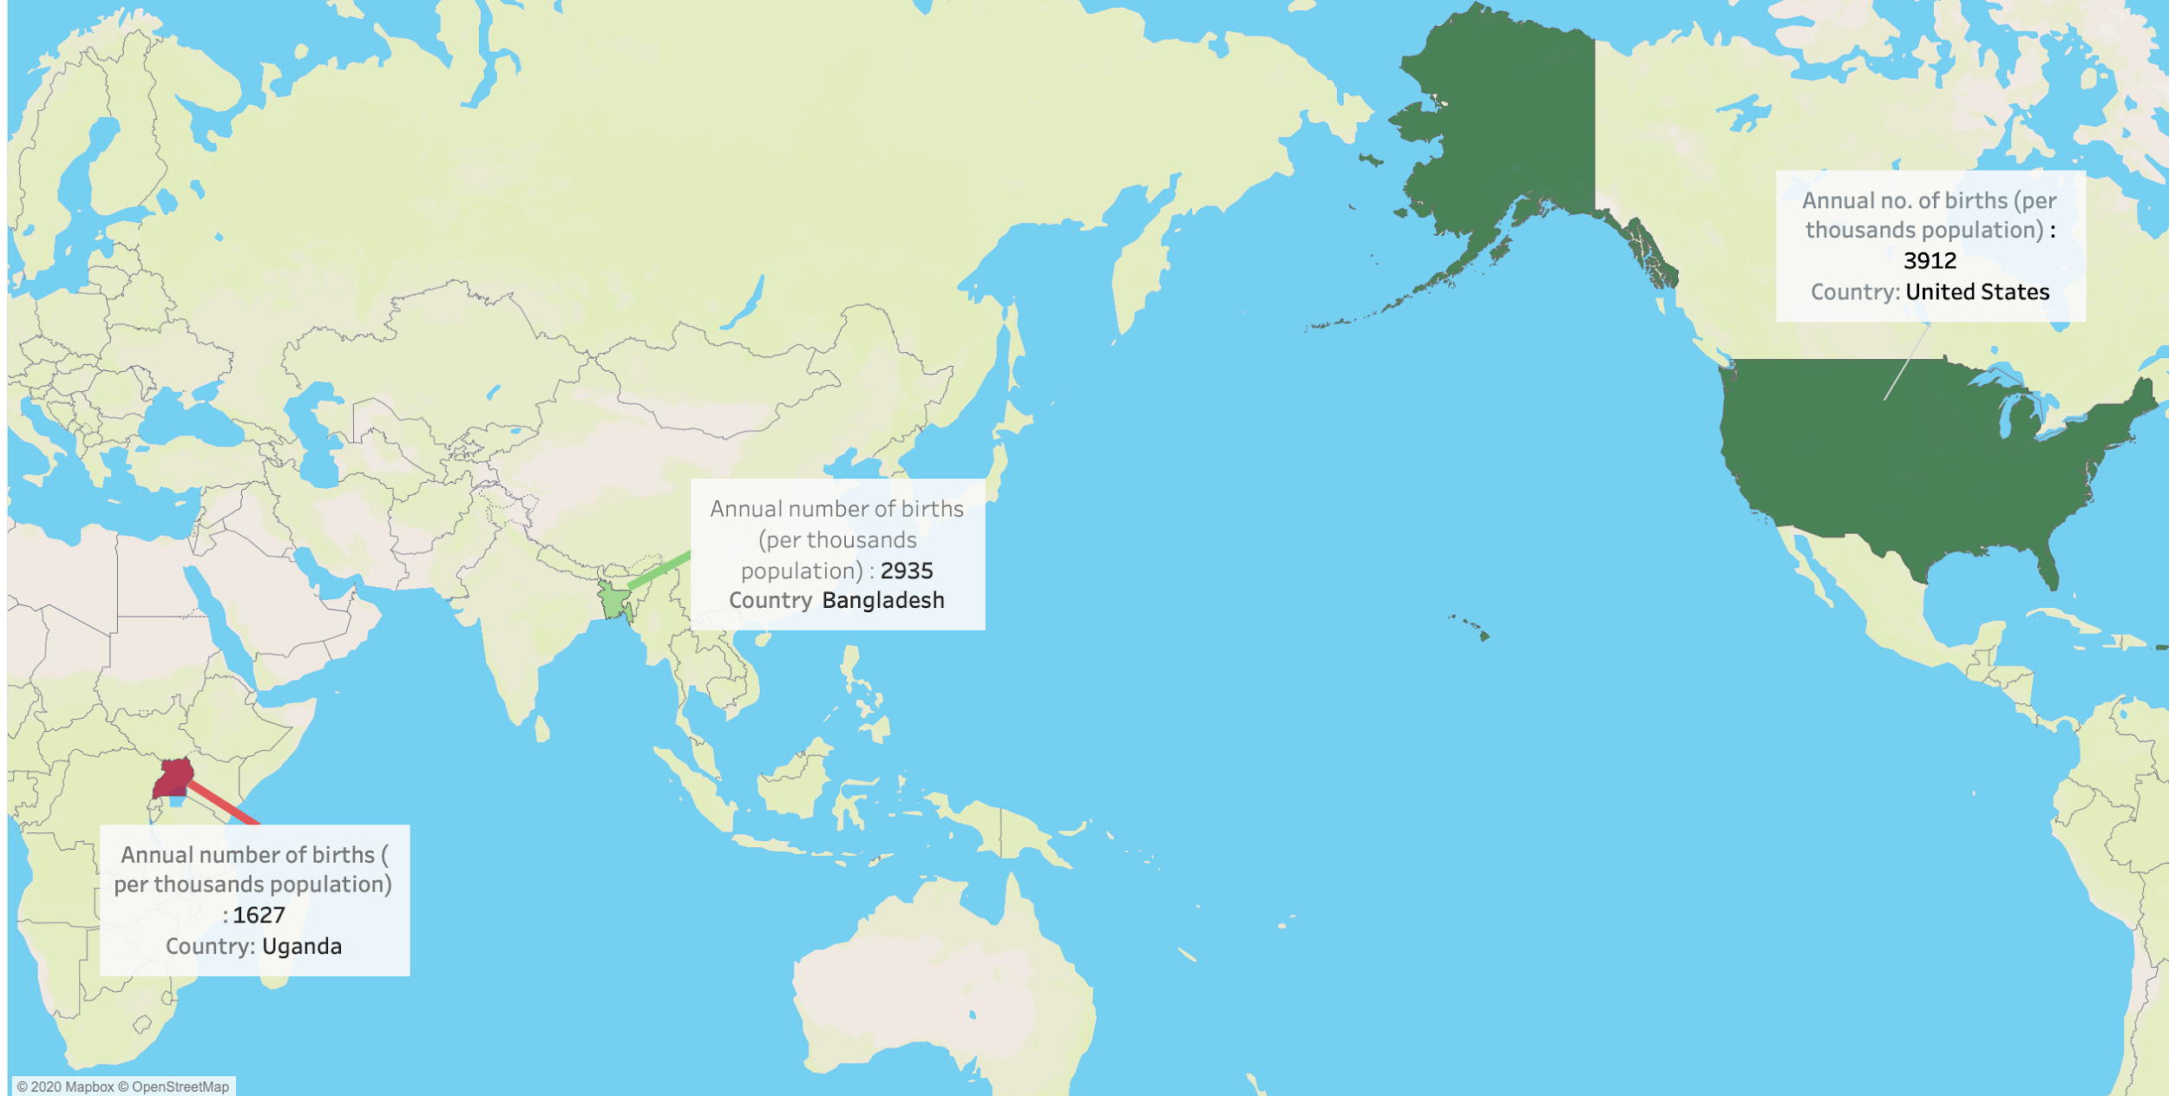
DEMOGRAPHICS
CAN YOU SPOT THE DIFFERENCE

Slide 6

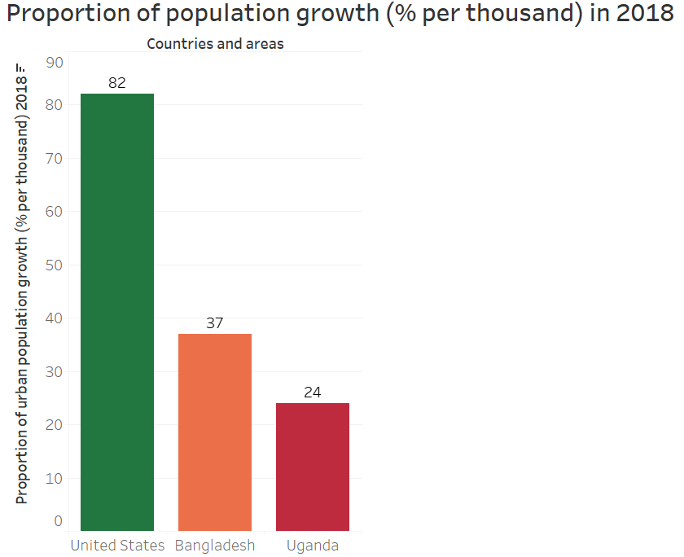
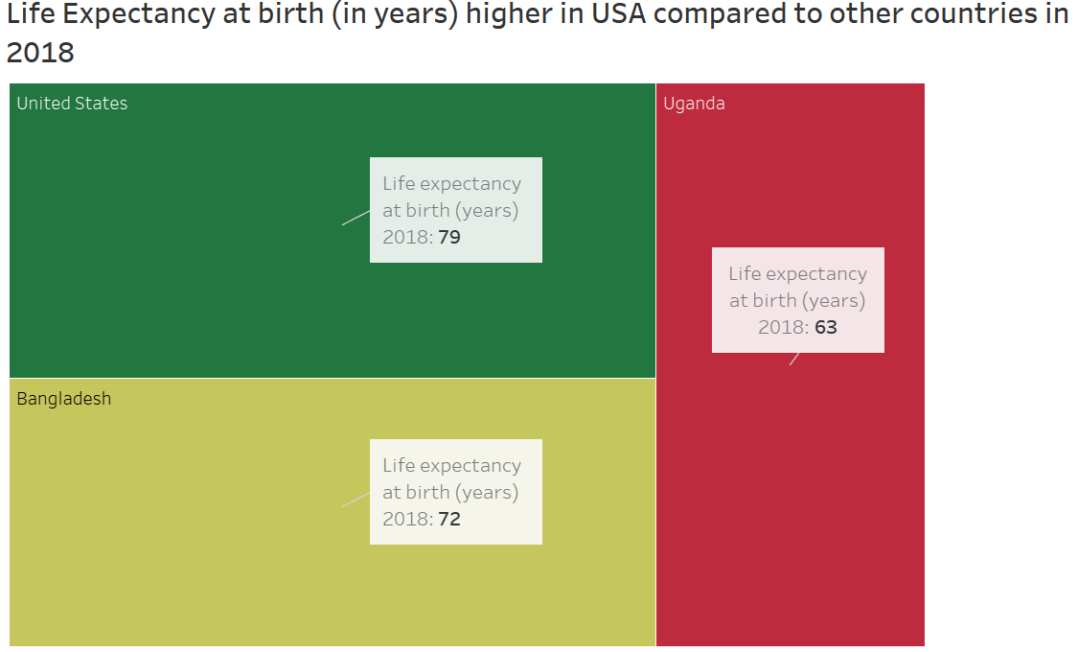
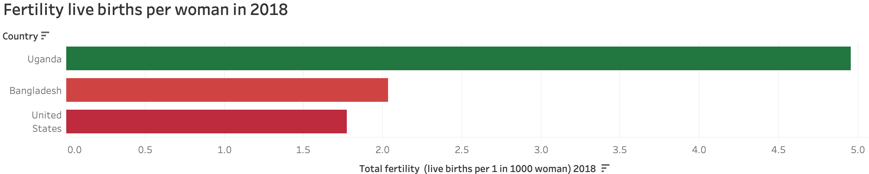
DEMOGRAPHICS
Notes:
united states - green
bangladesh - yellow

Slide 7

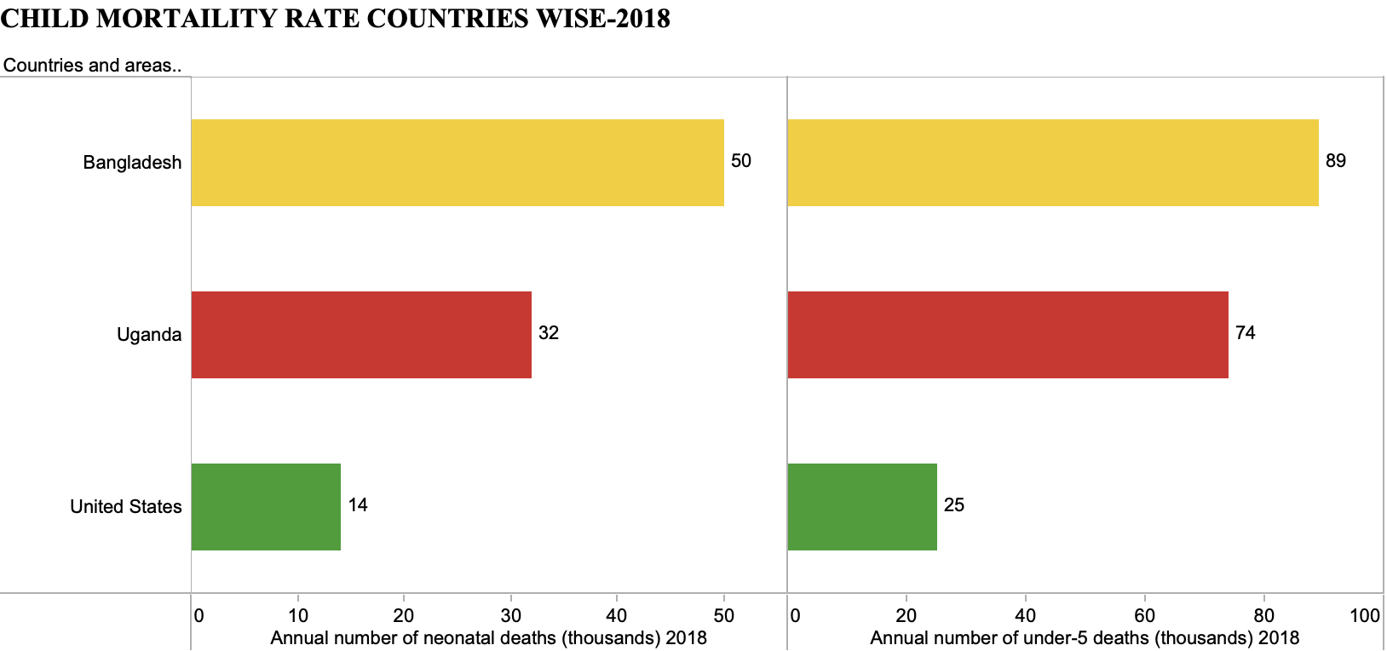

CHILD MORTALITY
Birth complications, Respiratory infections,
Congenital anomalies Diarrhea.
Under-5 Death Causes
Notes:
Harshini
Meaning of the terms
Comparing 3 countries

Slide 8
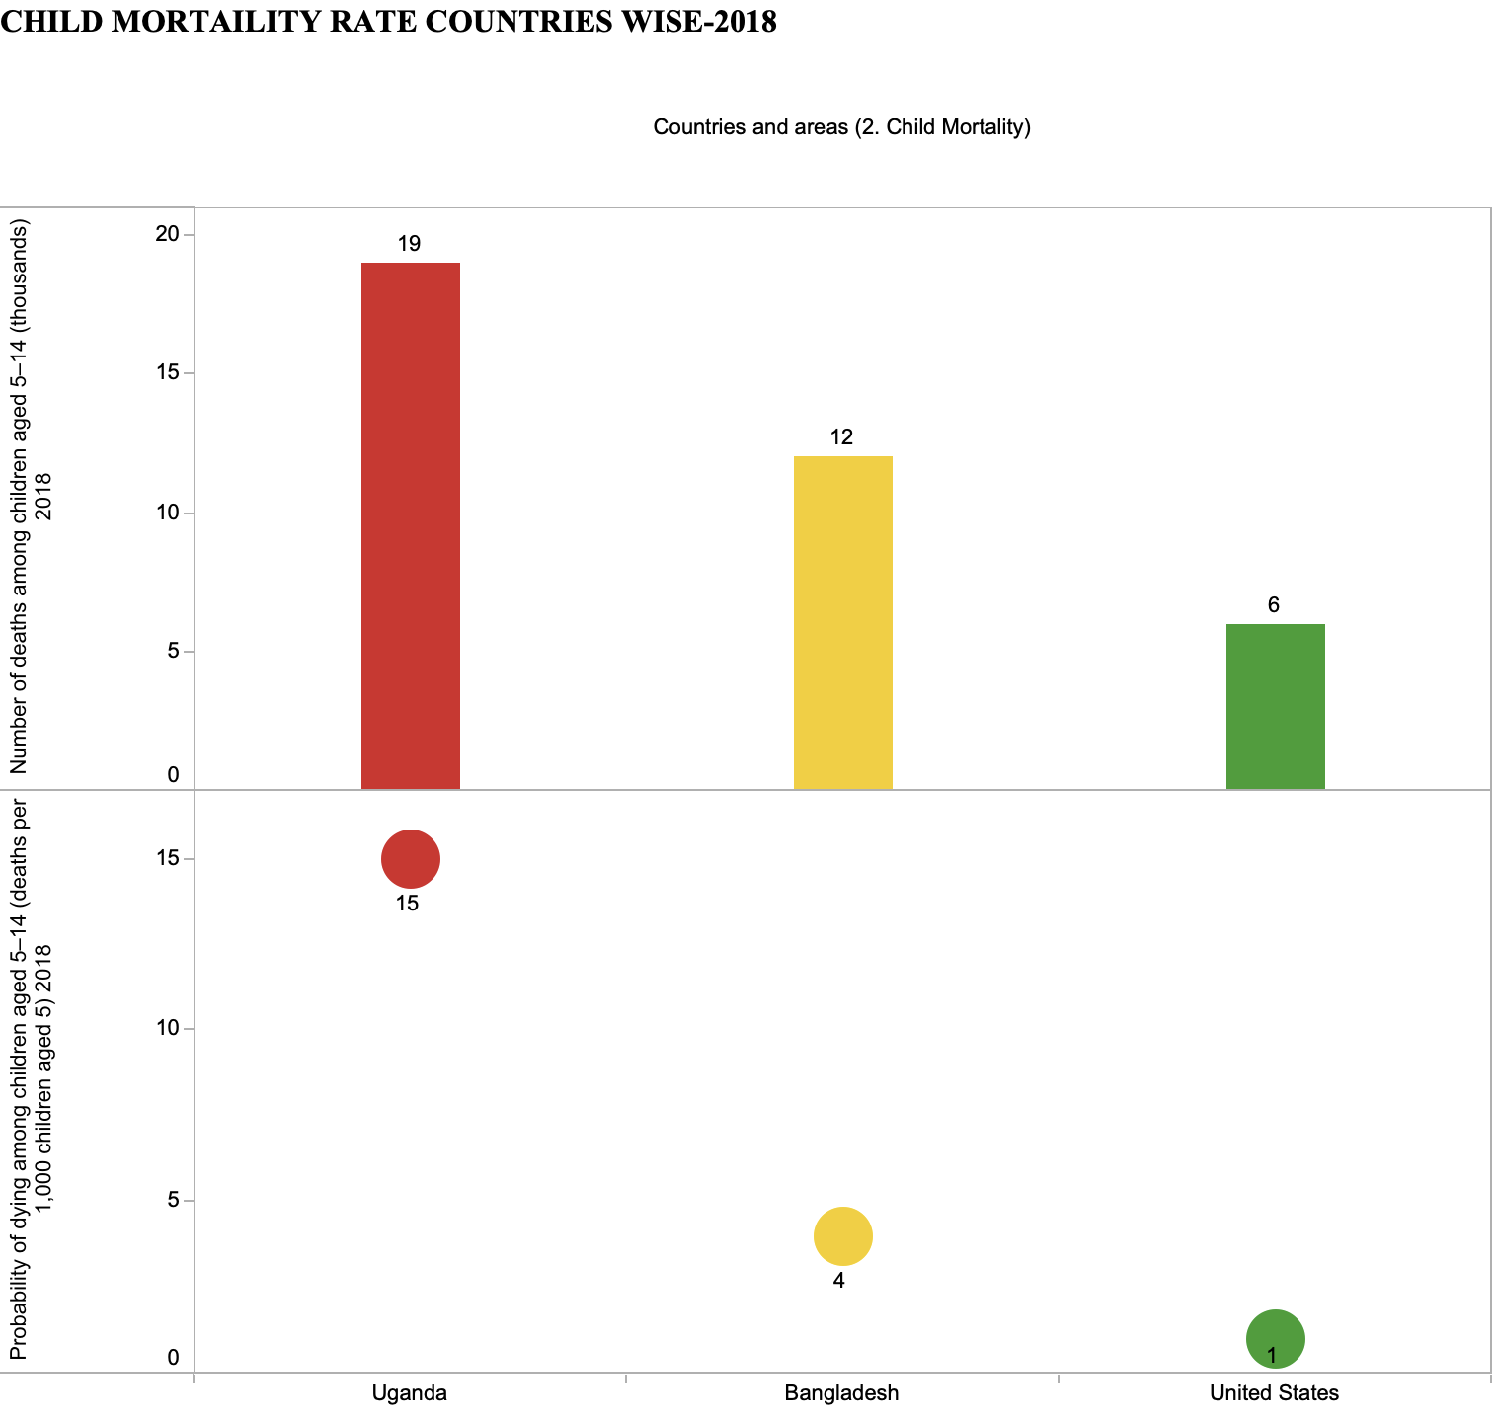

CHILD MORTALITY
"The care of children is a basic moral responsibility of our society,"
Notes:
Harshini
Age 5-14 - similar pattern

Slide 9

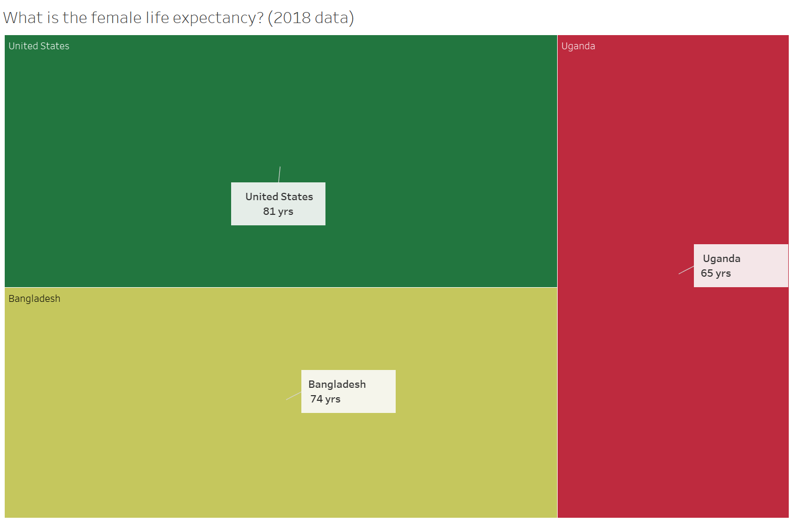
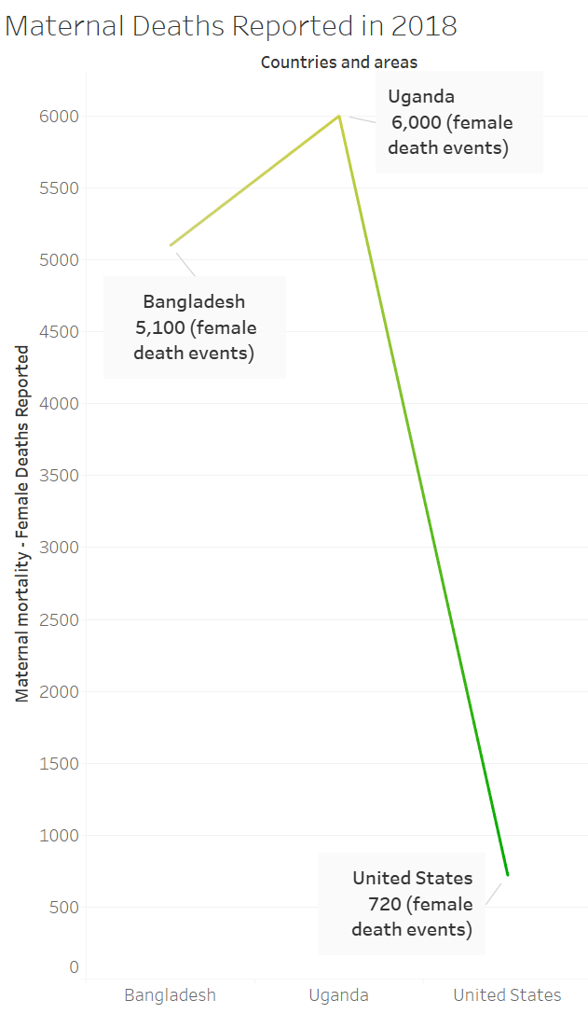
MATERNAL MORTALITY
Maternal life expectancy and death rate have deteriorated to a great extent
(2018)
Notes:
Jyoti
Life expentancy = years
Its the highest in USA and the death rate is highest in Uganda - this shows that not only the child health also maternal health is highly deteriorating depending upon our section bifurcation

Slide 10

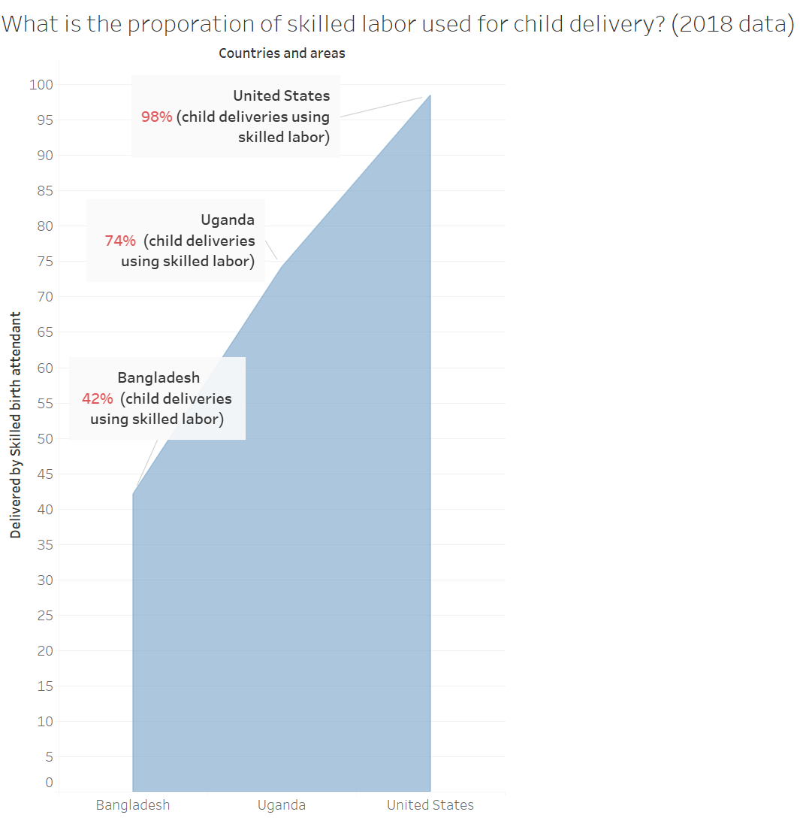
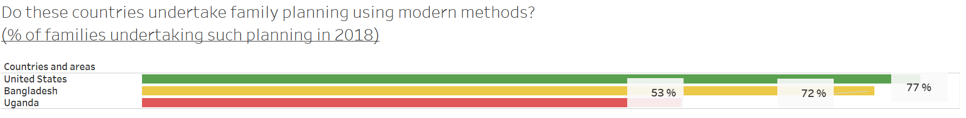
FACTORS CAUSING MATERNAL MORTALITY
What are the reasons for such high maternal mortality rate?
Notes:
Jyoti
Now the Q arises why is it so? Reason being - lack of modern family planning methods or skilled labor for delivery - we see that that this has a direct impact on the maternal health and life. Highlight UGANDA for skilled labor

Slide 11

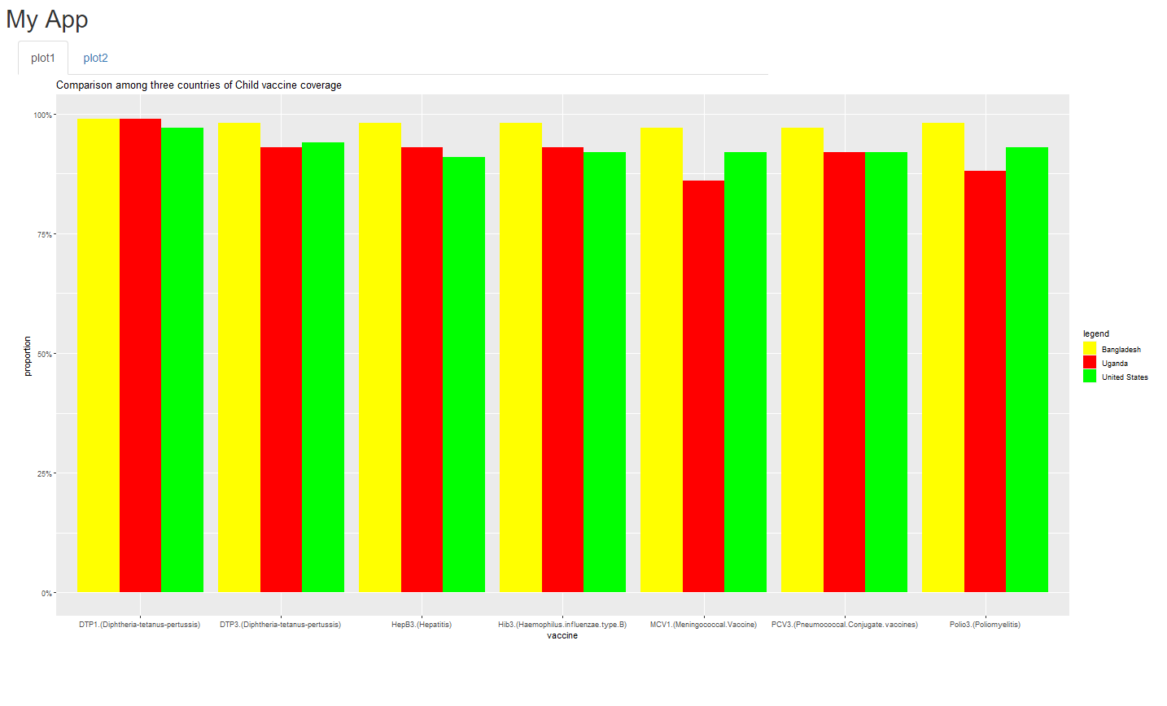
CHILD HEALTH
Comparison amongst three countries for Child vaccine
Notes:
Wan

Slide 12

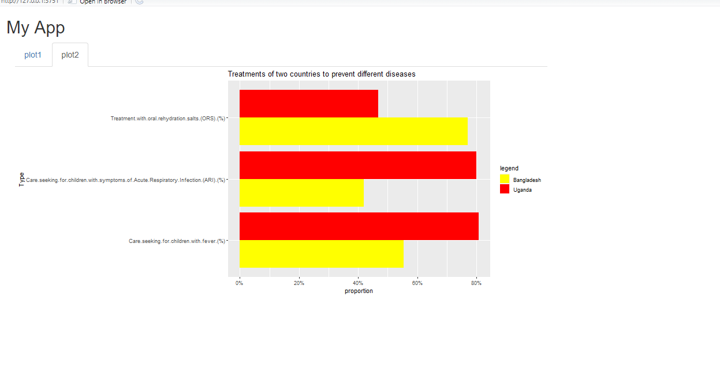
CHILD HEALTH
Different treatment of different area.
Notes:
Wan

Slide 13
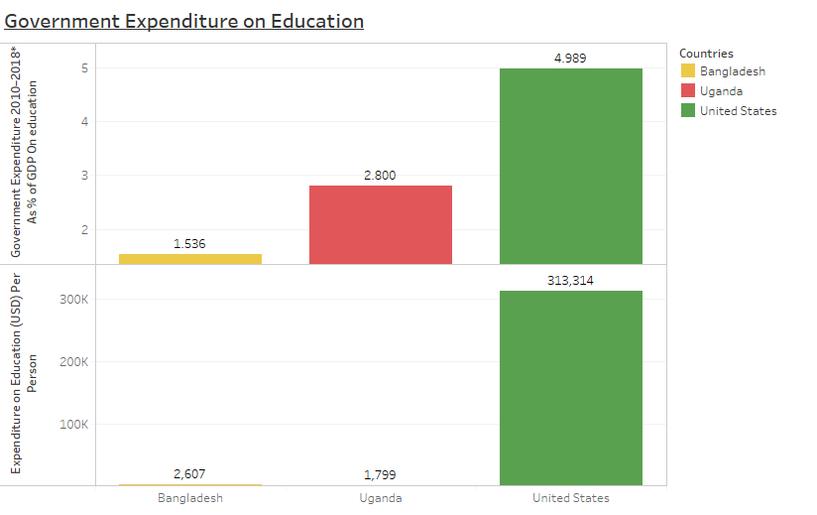

ECONOMIC INDICATORS
Notes:
Mayank

Slide 14
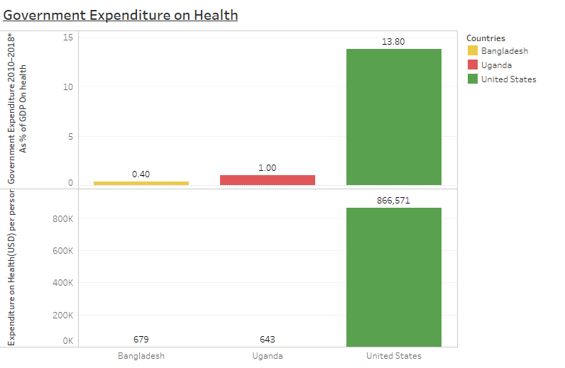

ECONOMIC INDICATORS
Notes:
Mayank

Slide 15
ACTION PLAN - REDUCE MORTALITY IN UGANDA & BANGLADESH
Improve skilled labor for delivering baby
Invest in taking care of child and mother during pregnancy and after birth
Improve skilled labor for delivering baby
Make vaccines
compulsory for all babies
Proper health care facility for child after birth
Notes:
Ankita
USA is a developed country
bangladesh -underdeveloped
uganda- developing
Annual birth rates in Uganda and Bangladesh can be improved by taking following steps :
Invest in taking care of child and mother during pregnancy and after birth
Improve skilled labor for delivering baby
Invest in educating mothers during pregnancy
Making vaccines compulsory for all babies
Proper health care facility for child after birth

Slide 16
REFERENCES
Unicef. (2019). UNICEF. Retrieved 22 October, 2020, from https://data.unicef.org/resources/dataset/sowc-2019-statistical-tables/
Trimble, M. (2018). US News. Retrieved 22 October, 2020, from https://www.usnews.com/news/best-countries/articles/2018-01-11/us-has-highest-child-mortality-rate-of-20-rich-countries
Who-Retrieved 22 October, 2020, from https://www.who.int/news-room/fact-sheets/detail/mortality-among-children-aged-5-14-years

Slide 17

THANK YOU

